Slide 1
Reactive JavaScript Architectures
With RxJS

Slide 2
Reactive Architectures
The Reactive Manifesto
"Responsive, Resilient, Elastic, & Message Driven"

Slide 3
Reactive Architectures
The Reactive Manifesto
ReactiveX
http://reactivex.io/

Slide 4
Intro to Reactive paradigms
With RxJS
Chris Pratt and Teddy Sterne

Slide 5
Intro to Reactive paradigms
With RxJS
Chris Pratt and Teddy Sterne

Slide 6
Agenda

Slide 7
ReactiveX
An API for asynchronous programming with observable streams.

Slide 8
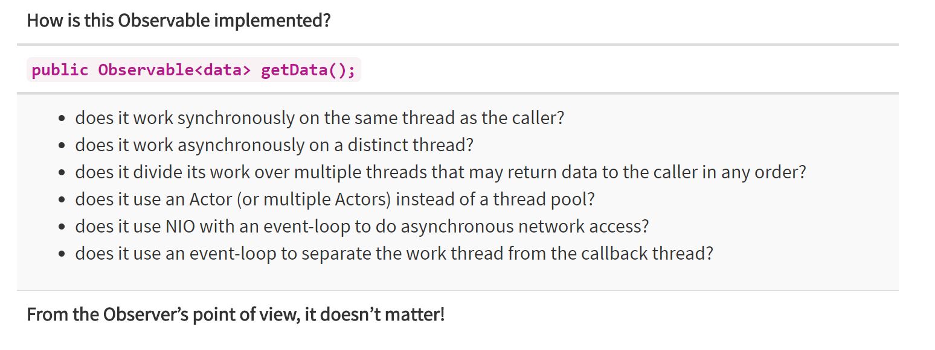
ReactiveX
http://reactivex.io/

Slide 9
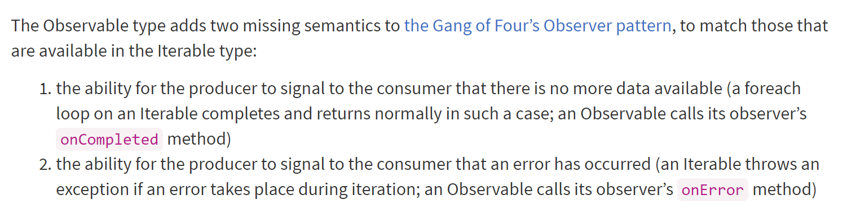
ReactiveX
http://reactivex.io/

Slide 10
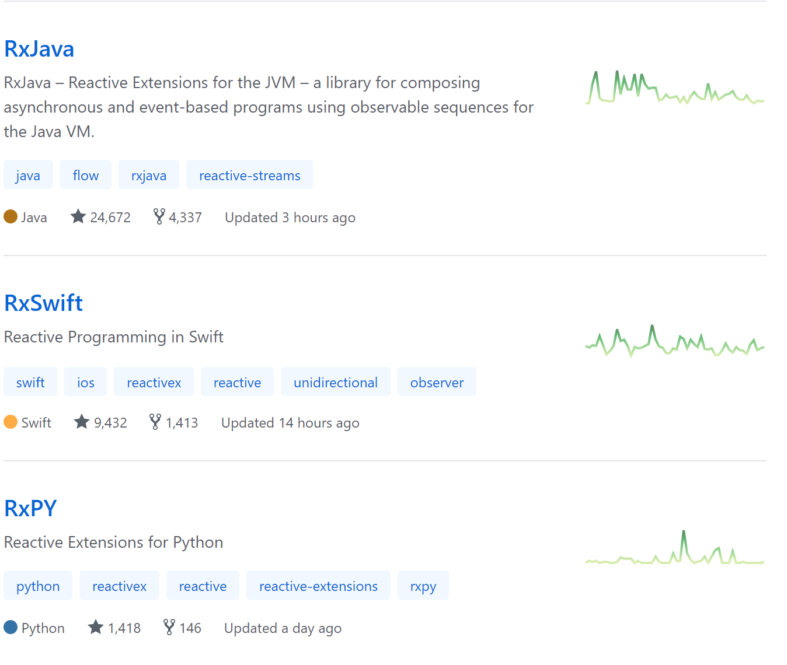
ReactiveX
ReactiveX

Slide 11
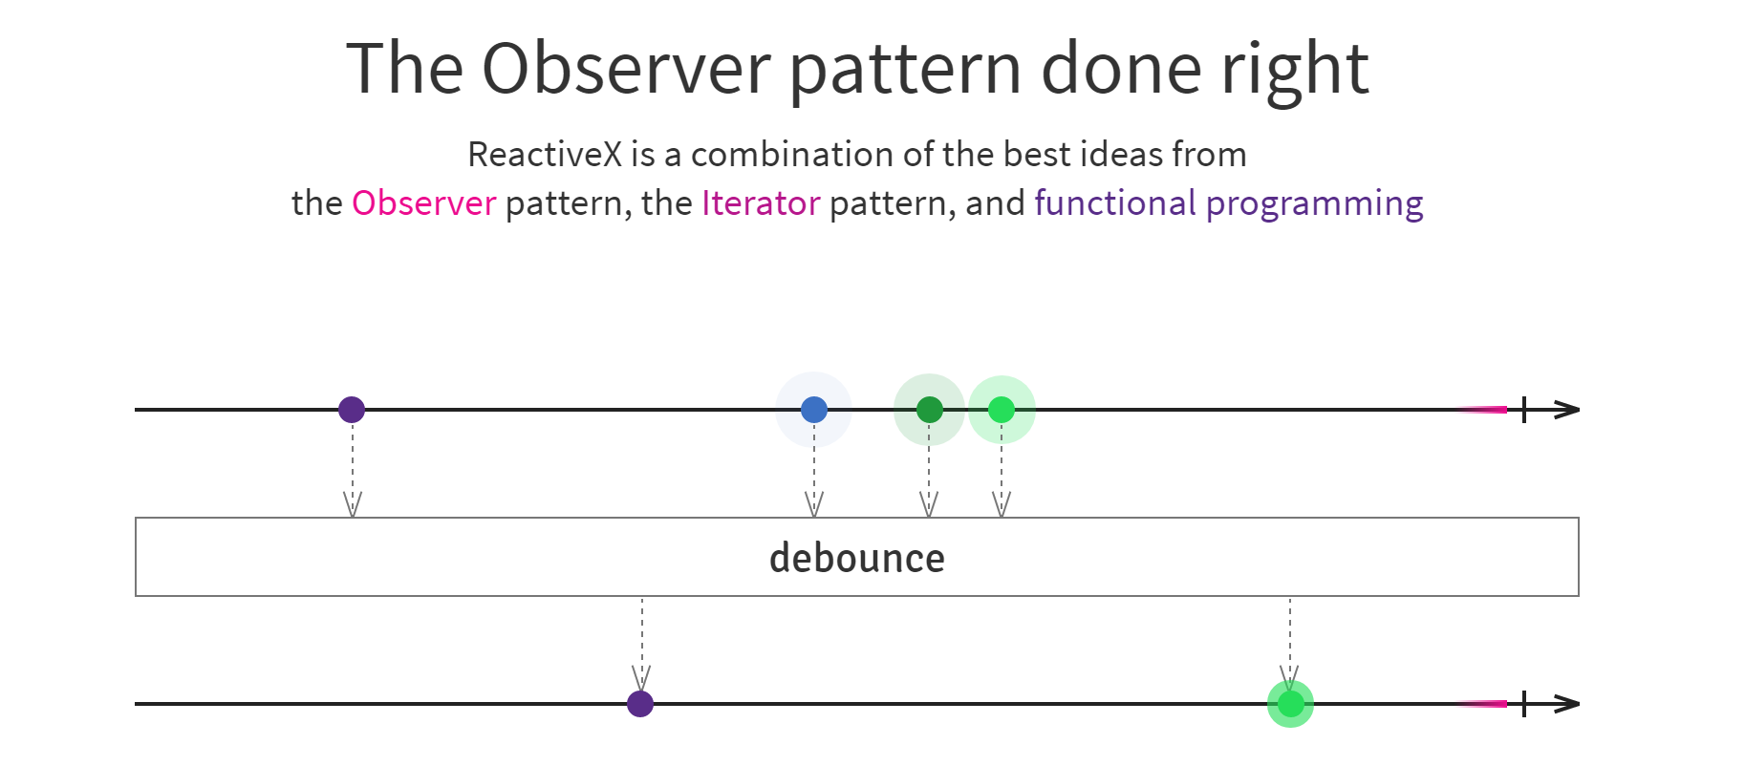
ReactiveX
ReactiveX
http://reactivex.io/

Slide 12
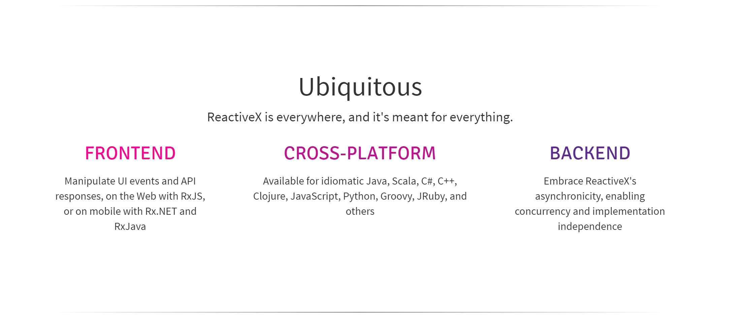
ReactiveX
ReactiveX
http://reactivex.io/

Slide 13
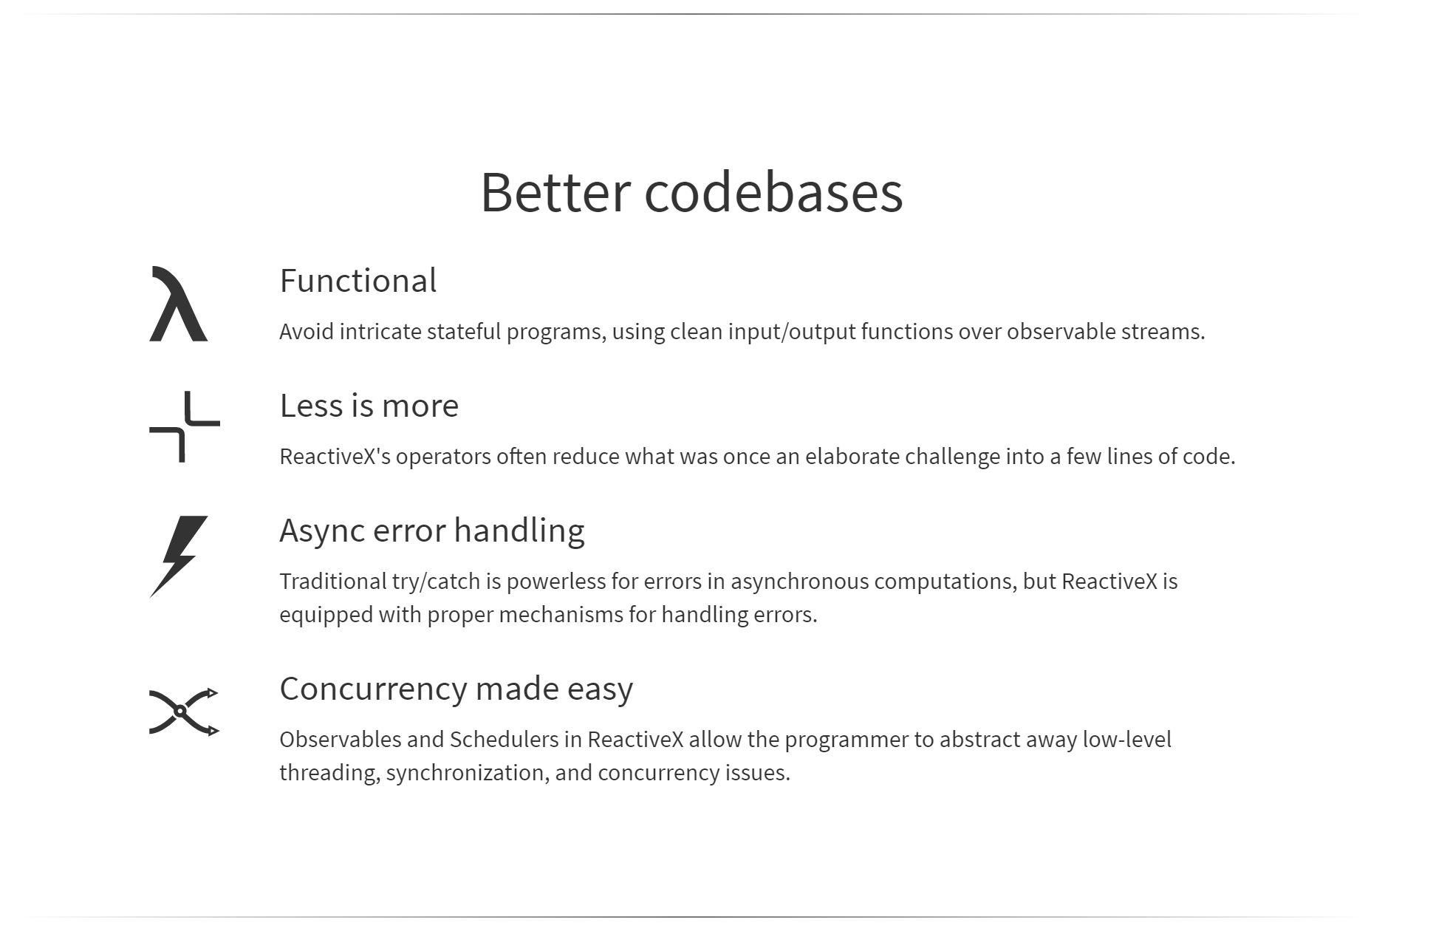
ReactiveX
ReactiveX
http://reactivex.io/

Slide 14
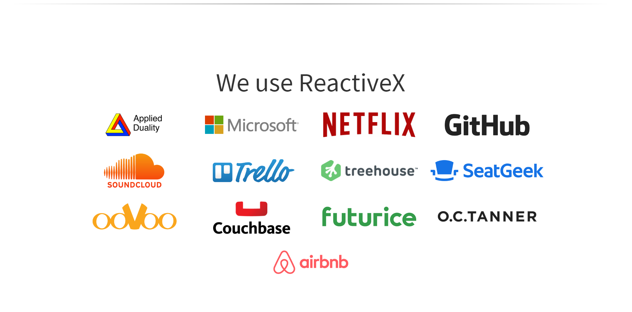
ReactiveX
ReactiveX
http://reactivex.io/

Slide 15
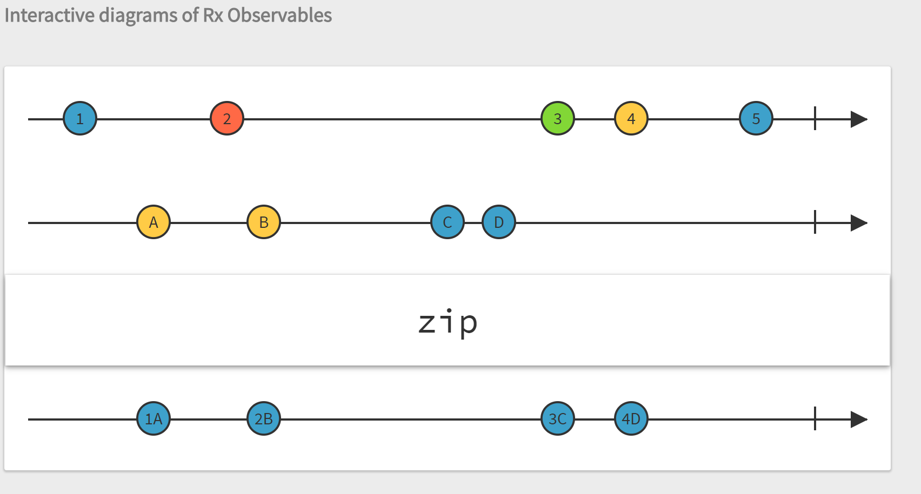
ReactiveX with Javascript
ReactiveX
http://rxmarbles.com/

Slide 16
Sounds like promises!
Promises are fine!
ReactiveX => Promises++

Slide 17
Just use promises!
Observables are cancellable
Observables can be retried
Observables can handle multiple events with the same API (it's a stream!)
Observables provide powerful operators to reduce extra code.

Slide 18
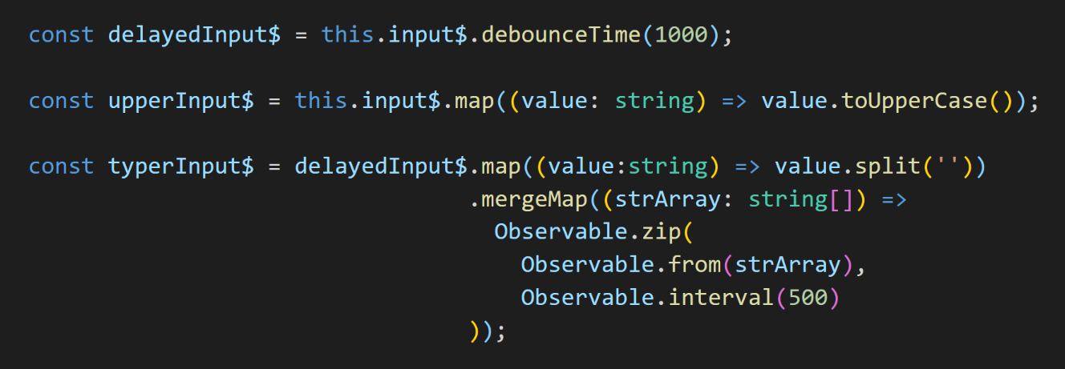
Just use promises!

Slide 19


But why javascript?

Slide 20
But why javascript?
Events
Promises
Http Calls
Web Sockets
Multiple Sources
Modular

Slide 21
Downsides
Modularity can be confusing
Documentation is good, but scattered
Large footprint, especially if you aren't careful

Slide 22

But why javascript?

Slide 23
RxJS
Overview of reactive architecture
why would i use it (promises are good?)
Lots of implementations
Use cases
What is RxJS
Why would you use RxJS
Endorsed by Angular and Angular is HOT
Supports many JavaScript concepts (promise, events)
Benefits over other solutions
Downside (size (but it is modular))
Observables
Observers
Subject
Funnel Diagram
Common Operators
Demos
Resources for RxJS

Slide 24
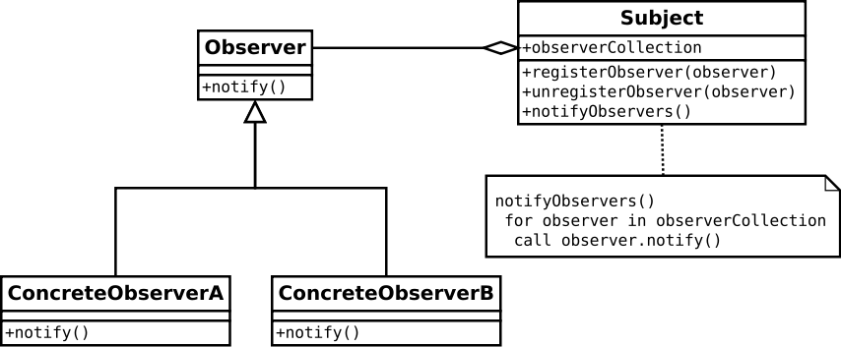
Observer Pattern
Observable
Observer

Slide 25
Observable
The object that sends notifications (the provider)
Notifications can be influenced using operators
Data in notifications can be modified
Has three events it emits: onNext, onError, onComplete
Can be observed
Extensions
ConnectableObservable – Waits for .connect() before notifying

Slide 26
Observers
Listens for events from the object it is subscribed to

Slide 27
Subjects
Is both an Observable and an Observer
Can be subscribed to
Can subscribe to an Observable
Extensions
ReplaySubject – stores all published values and replays on subscribe
BehaviorSubject – stores most recent value and replays on subscribe
AsyncSubject – replays most recent value even after complete

Slide 28
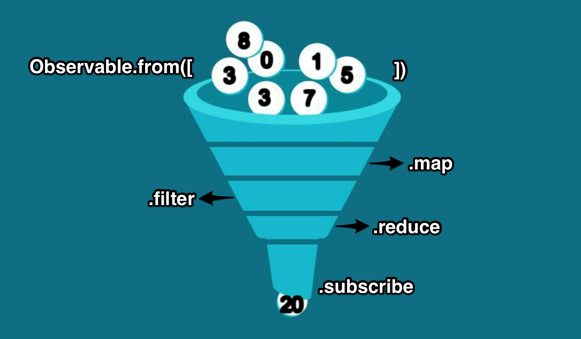

Slide 29



Operators
Trans-
formation
Combination
Filtering

Slide 30
Filtering

Slide 31
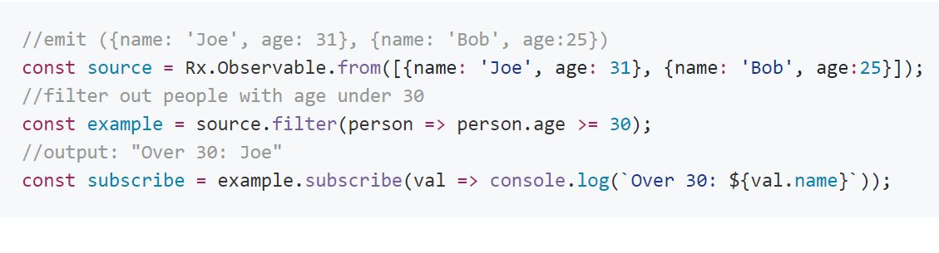
filter
filter(select: Function): Observable
Notes:
Emit values that pass the provided condition.
//emit ({name: 'Joe', age: 31}, {name: 'Bob', age:25}) const source = Rx.Observable.from([{name: 'Joe', age: 31}, {name: 'Bob', age:25}]); //filter out people with age under 30 const example = source.filter(person => person.age >= 30); //output: "Over 30: Joe" const subscribe = example.subscribe(val => console.log(`Over 30: ${val.name}`));

Slide 32
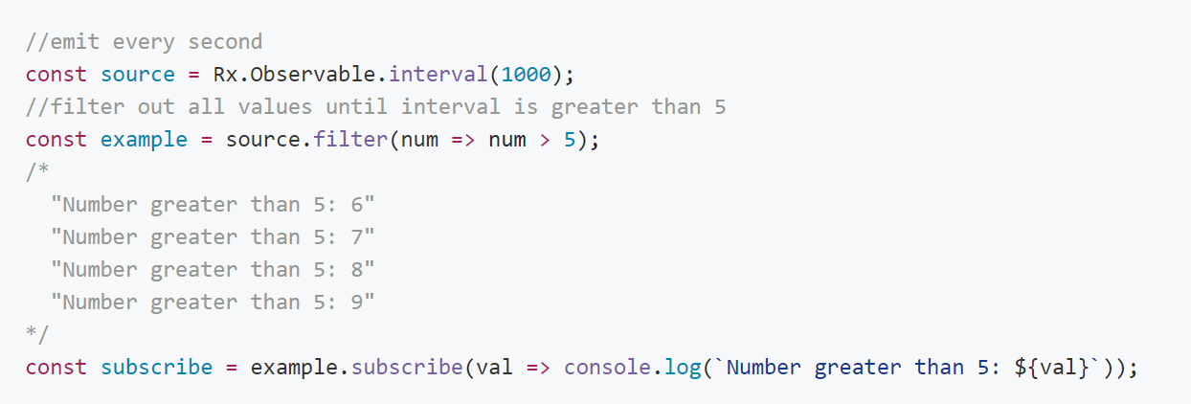
filter
filter(select: Function): Observable
Notes:
Emit values that pass the provided condition.
//emit every second const source = Rx.Observable.interval(1000); //filter out all values until interval is greater than 5 const example = source.filter(num=> num > 5); /* "Number greater than 5: 6" "Number greater than 5: 7" "Number greater than 5 : 8" "Number greater than 5: 9" */ const subscribe = example.subscribe(val => console.log(`Number greater than 5: ${val}`));

Slide 33
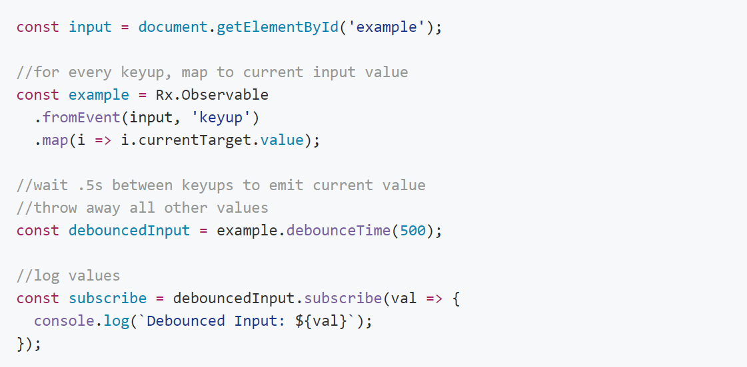

debounceTime
debounceTime(dueTime: number, scheduler: Scheduler): Observable
Notes:
Discard emitted values that take less than the specified time, based on selector function, between output.
const input = document.getElementById('example'); //for every keyup, map to current input value const example= Rx.Observable.fromEvent(input, 'keyup') .map(i => i.currentTarget .value); //wait .5s between keyups to emit current value //throw away all other values const debouncedInput = example .debounceTime(500); //log values const subscribe = debouncedInput.subscribe(val => { console.log(`Debounced Input: ${val}`); });

Slide 34
OTHER POPULAR FILTERS
DistinctUntilChange – only emit when current value is different than last
Take – emit X number of times then complete
First – emit first value and complete
Last – emit last value before complete

Slide 35
Trans-
formation

Slide 36

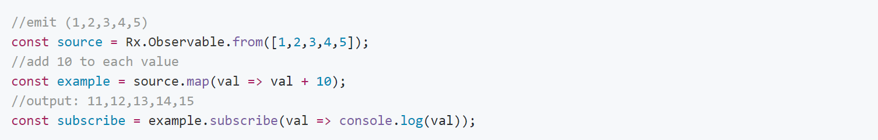
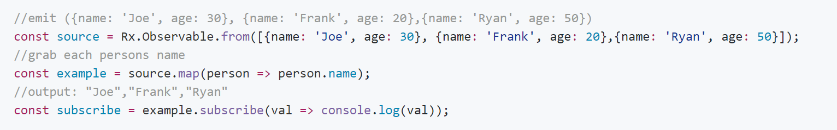
map
map(project: Function): Observable
Notes:
Apply projection with each value from source.
//emit (1,2,3,4,5) const source = Rx.Observable.from([1,2,3,4,5]); //add 10 to each value const example = source.map(val=> val + 10); //output: 11,12,13,14,15 const subscribe = example.subscribe(val => console.log( val));
//emit ({name: 'Joe', age: 30}, {name: 'Frank', age: 20},{name: 'Ryan', age: 50}) const source = Rx.Observable.from([{name: 'Joe', age: 30}, {name: 'Frank', age: 20},{name: 'Ryan', age: 50}]); //grab each persons name const example = source.map(person => person.name); //output: "Joe","Frank","Ryan" const subscribe = example.subscribe(val => console.log(val));

Slide 37
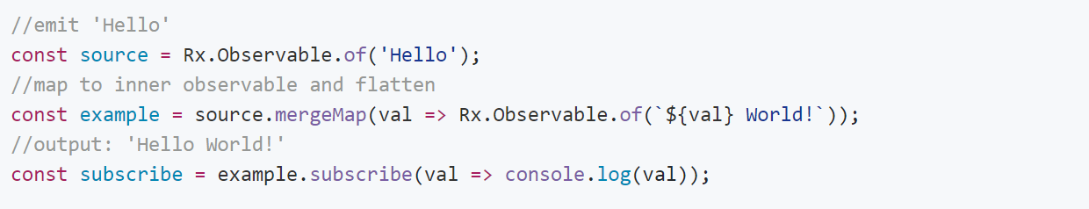
mergeMap
mergeMap(project: Function: Observable): Observable
Notes:
Map to observable, emit values.
//emit 'Hello' const source = Rx.Observable.of('Hello'); //map to inner observable and flatten const example = source.mergeMap(val => Rx.Observable.of(`${val} World!`)); //output: 'Hello World!' const subscribe = example.subscribe(val => console.log(val));

Slide 38
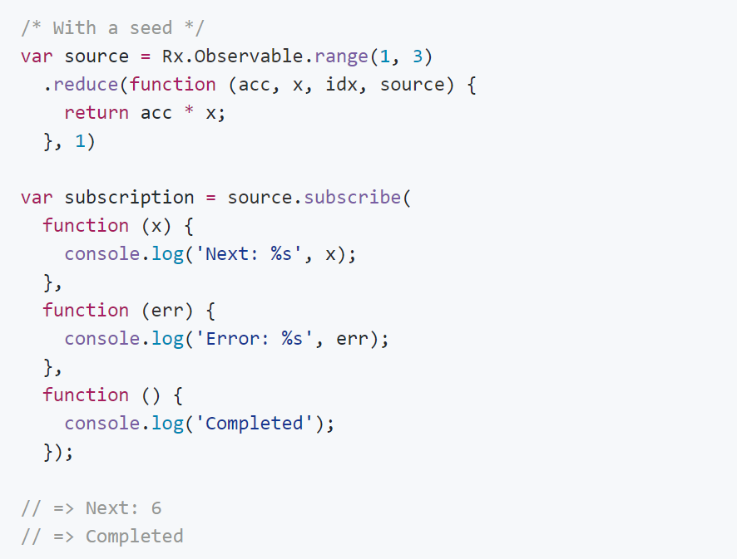
reduce
reduce(accumulator: Function, seed: any): Observable
Notes:
Applies an accumulator function over an observable sequence, returning the result of the aggregation as a single element in the result sequence. The specified seed value is used as the initial accumulator value.
/* With a seed */ var source = Rx.Observable.range(1, 3) .reduce(function(acc, x, idx, source) { return acc * x; }, 1) var subscription= source.subscribe( function (x) { console.log('Next: %s', x); }, function (err) { console.log('Error: %s', err); }, function () { console.log('Completed'); }); // => Next: 6 // => Completed

Slide 39
OTHER POPULAR TRANSFORMATION OPERATORS
ConcatMap – Similar to MergeMap but maintains order
Scan – Similar to reduce but operates over time and emits after each new value
BufferTime – Emit all values that occurred during a set period of time.
Notes:
http://jsbin.com/tufeger/edit?js,console

Slide 40
Combination

Slide 41
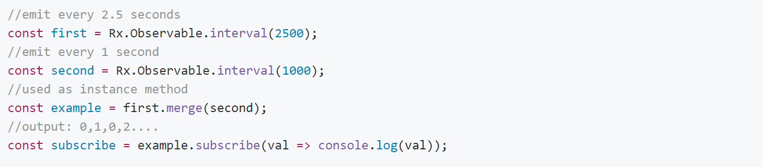
merge
merge(input: Observable[, … [, input: Observable]]): Observable
Notes:
Turn multiple observables into a single observable.
//emit every 2.5 seconds const first = Rx.Observable.interval(2500); //emit every 1 second const second = Rx.Observable.interval(1000); //used as instance method const example = first.merge(second); //output: 0,1,0,2.... const subscribe = example.subscribe(val => console.log(val));

Slide 42
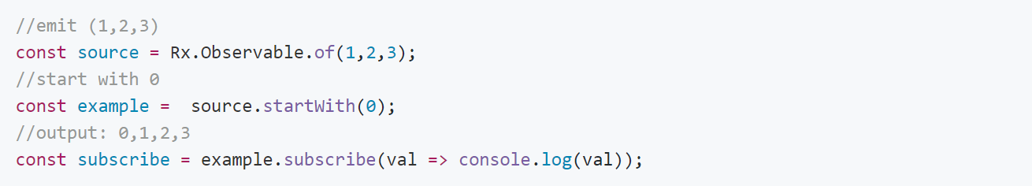
startWith
startWith(value: any): Observable
Notes:
Emit given value first.
//emit (1,2,3) const source= Rx.Observable.of(1,2,3); //start with 0 const example = source.startWith(0); //output: 0,1,2,3 const subscribe = example.subscribe(val => console.log(val));

Slide 43
OTHER POPULAR COMBINATION OPERATORS
CombineLatest – Whenever one emits, emit latest from others
Concat – Similar to Merge but maintains order
WithLatestFrom – provide the last value from another observable when first one emits.
ForkJoin - When all observables complete emit the last value from each.

Slide 44
Demo Time!
http://chat-app-tsterne.herokuapp.com/

Slide 45
Resources
Official Docs - http://reactivex.io/rxjs/
Clear examples, explanations, and resources for RxJS - https://github.com/btroncone/learn-rxjs
What operator should I use? - http://bit.ly/2ryFnQO
Live Examples up to v4.0 of RxJS - http://xgrommx.github.io/rx-book/index.html
This Presentation and Code - https://github.com/sternetj/rxjs-presentation

